Slide 1

Advanced R
Tools for Advanced Data Analytics in R
A Course Designed by Data Smart Science
&
Presented by
Dr. Eric Asare & Seth Appiah

Slide 2
Recap of last’s week lesson
Apply()
apply(df, 2, sum)
apply(df[ c(1, 3), ], 1, sum)
apply(df[, c(1, 3)], 2, sum)
Lapply()
Apply family (ALASVATM)
Sapply()
Vapply()
Tapply()
Mapply ()

Slide 3
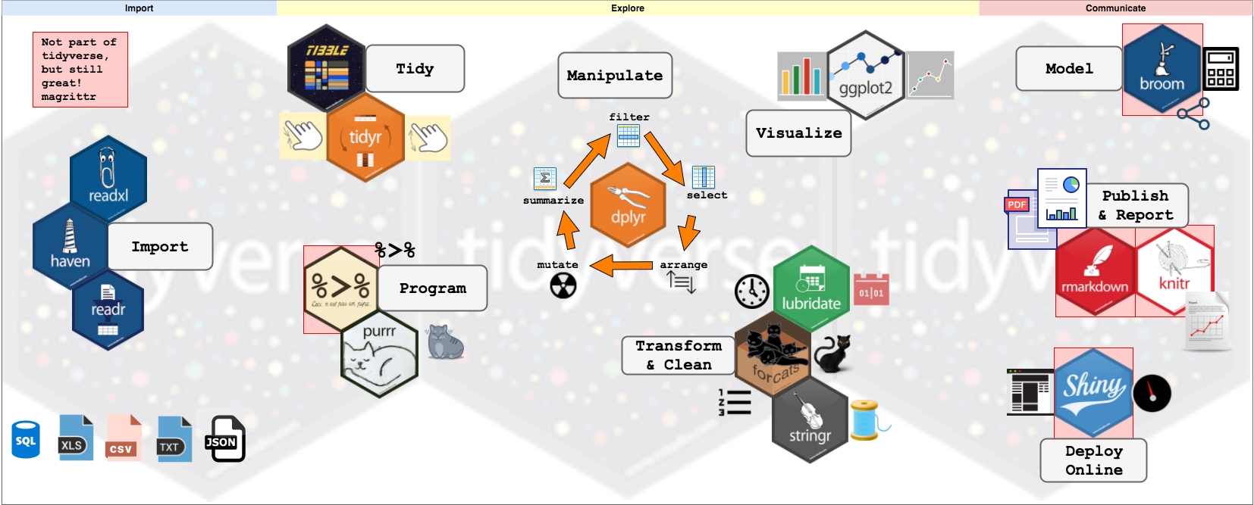
Tidyverse

Slide 4
Today’s Outline
Applying functions to a single list’
Applying functions to 2 lists
Applying functions to more than 2 lists

Slide 5
Today’s Outline
Square_root <- function(x) {
x^1/2
}
Function(x) x^1/2
List %>%
map(~ . ^1/2)
~ : tells function is coming
. : function argument

Slide 6
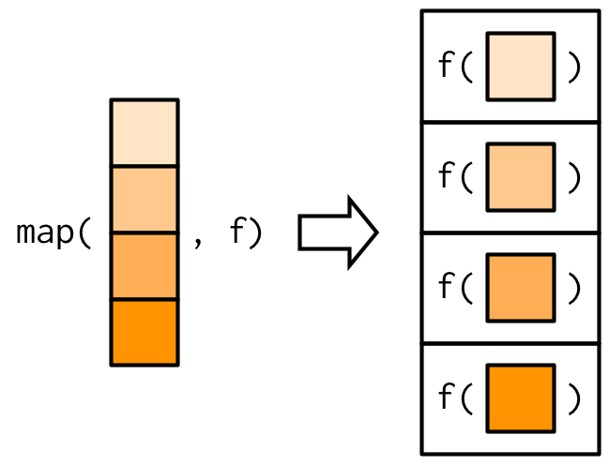
Map(): Applying functions to single list
The output of map() is always a list
What if we want to return a vector output of
a specific datatype?
Map_int(): returns an integer vector
Map_dbl(): returns a double vector
Map_chr(): character vector
Map_lgl(): logical vector

Slide 7
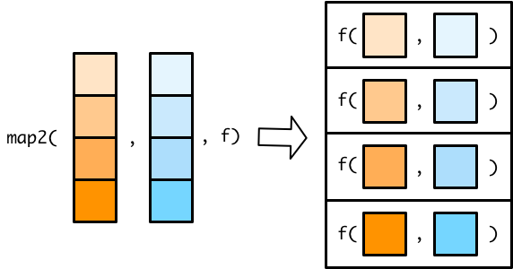
Map2(): Applying functions to 2 lists
Output of map2() is a list.
What if we want to return a vector output of
a specific datatype?
Map2_int(): returns an integer vector
Map2_dbl(): returns a double vector
Map2_chr(): character vector
Map2_lgl(): logical vector

Slide 8
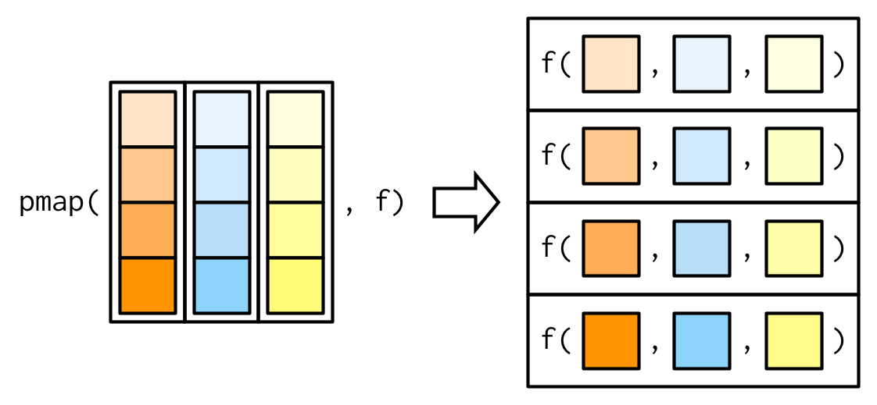
Today’s Outline
Output of map2() is a list.
What if we want to return a vector output of
a specific datatype?
pmap_int(): returns an integer vector
pmap_dbl(): returns a double vector
pmap_chr(): character vector
pmap_lgl(): logical vector

Slide 9
Today’s Outline
Drops Null
ls4 <- list(23, NULL, NA, 34)
compact(ls4)
Filtering list
ls1 <- list("R", "Statistics", "Blog")
pluck(ls1, 2)
head_while() – An interesting function, the function kind of checks for the logical condition for each element in the list starting from the top and returns head elements until one does not pass the logical test.
Observe values that passes a test
ls2 <- list(23, 12, 14, 7, 2, 0, 24, 98)
keep(ls2, function(x) x > 5)
ls5 <- list("R", "Statistics", "Blog", 2, 3, 1)
head_while(ls5, is.character)
Observe values that do not pass a test
ls3 <- list(23, NA, 14, 7, NA, NA, 24, 98)
discard(ls3, is.na)

Slide 10
Today’s Outline
every() – This function returns TRUE if all the elements in a list pass a condition or test
sm1 <- list("R", 2, "Rstatistics", "Blog")
every(sm1, is.character)
has_element() – The function returns true if the list contains the element mentioned.
sm2 <- list("R", 2, "Rstatistics", "Blog")
has_element(sm2, 2)
some() – it is similar to the every()
as in it checks for a condition towards all the elements inside a list but return TRUE if even one value passes the test or logic.
sm2 <- list("R", 2, "Rstatistics", "Blog")
some(sm1, is.character)
detect() – Returns the first element that passes the test or logical condition. Here the function will return the element itself
sm3 <- list("R", 2, "Rstatistics", "Blog", 3)
detect(sm3, is.numeric)

Slide 11
Today’s Outline
detect_index() – Just like detect this function, also checks for the elements which pass the test and return the index of the first element from the list.
sm4 <- list(2, "Rstatistics", "Blog", TRUE)
detect_index(sm4, is.logical)

Slide 12
Dplyr Package
The grammar of Dplyr
select() : select columns
Filter() : Select rows
Arrange() : sort columns
Rename() : Rename variables
Mutate(): Transform existing columns or add new columns
Group_by() : To conduct grouped data manipulations
summarize(): Create summary statistics
%>% : Pipes which links multiple data manipulation actions together

Slide 13
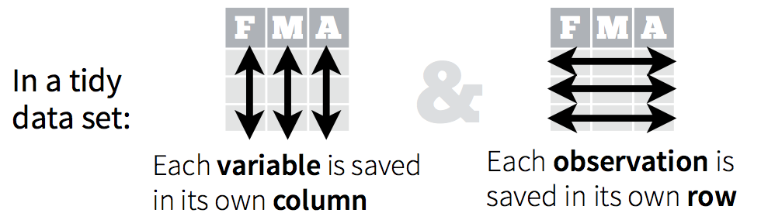
Dplyr Package
It is an awesome package for working with tidy data
What is a tidy data. It has the following characteristics:

Slide 14
Commenting
Resources to review before next week’s class:
Commenting:
Best practices for writing code comments - Stack Overflow Blog
GitHub and R-studio: The pdf file is in the Advanced R week 3 folder
Code review:
Code Reviews (github.com)
Pull request:
How to make your first pull request on GitHub (freecodecamp.org)

Slide 15
Lab Section
R folder management system.
Writing function scripts and sourcing.
Apply Dplyr package on Gapminder Data.

Slide 16
Key resource future sessions
Welcome | Advanced R (hadley.nz)
Welcome | R for Data Science (had.co.nz)

